Slide 1

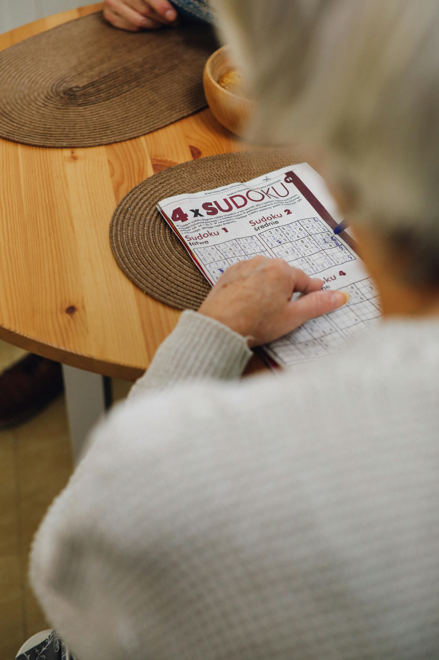

Sudoku solver visualizer
Aarjav jain
9sk02

Slide 2

Sudoku solver visualizer

Slide 3
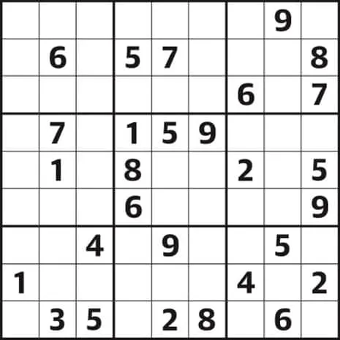

This report covers the implementation and functionality of a Sudoku solver with a graphical user interface (GUI) written in Java.
What is Sudoku?
Sudoku is a logic-based, combinatorial number-placement puzzle.
Objective: Fill a 9x9 grid with digits so that each column, each row, and each of the nine 3x3 subgrids contain all of the digits from 1 to 9.
Rules:
Each row must contain the numbers 1-9 without repetition.
Each column must contain the numbers 1-9 without repetition.
Each of the nine 3x3 subgrids must contain the numbers 1-9 without repetition.
1. Introduction

Slide 4
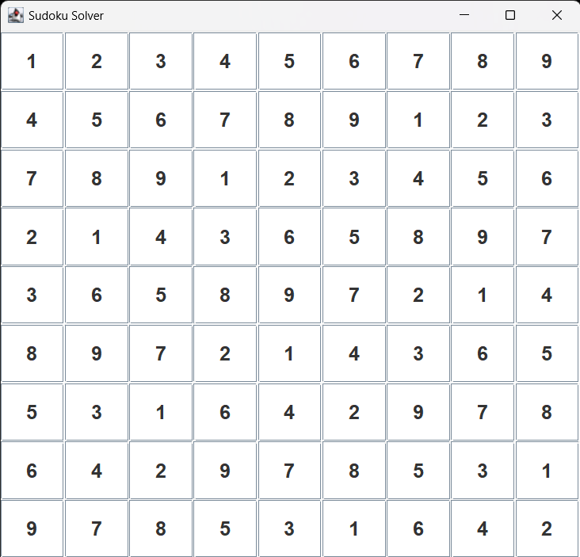
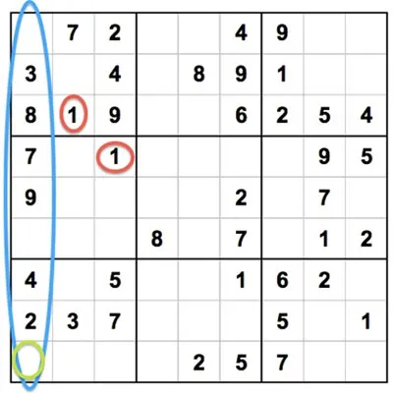

GUI Setup
GUI Setup
Components of the GUI:
JFrame: The main window of the application
GridPanel: A 9x9 grid of JTextField components representing the Sudoku board
ButtonPanel: Contains buttons for loading a puzzle, solving it, and clearing the board

Slide 5
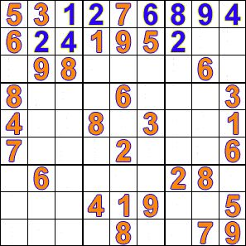
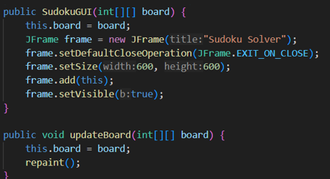
Initialization
Tracking Arrays:
rows, cols, subgrids: Arrays to keep track of numbers already present in each row, column, and 3x3 subgrid to ensure Sudoku rules are followed
Load Puzzle
loadPuzzle Method:
Initializes the board with a predefined puzzle
Sets non-zero cells to be non-editable
Updates the tracking sets (rows, cols, subgrids)
SudokuGUI Class Initialization

Slide 6
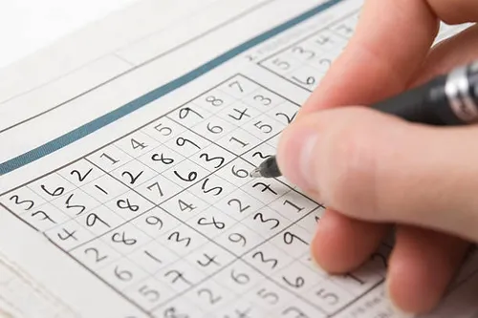
Solve Puzzle
solvePuzzle Method:
Starts the solving process in a new thread to keep the GUI responsive
Backtracking Algorithm:
findEmptyCell: Finds the next empty cell
isValid: Checks if placing a number violates Sudoku rules
Recursive Solving: Tries numbers 1-9, backtracking if a conflict arises
updateGUI: Updates the GUI to visualize the solving steps
Solve Puzzle

Slide 7
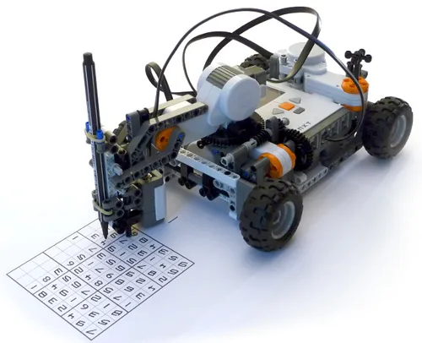
This Sudoku solver with a GUI demonstrates the integration of a backtracking algorithm with a graphical interface, allowing users to visualize the solving process. The combination of SudokuGUI for rendering the board and SudokuSolver for solving the puzzle creates an interactive and educational tool for understanding how Sudoku puzzles can be solved programmatically.
Conclusion

Slide 8
Sudoku solver visualizer

